Slide 1
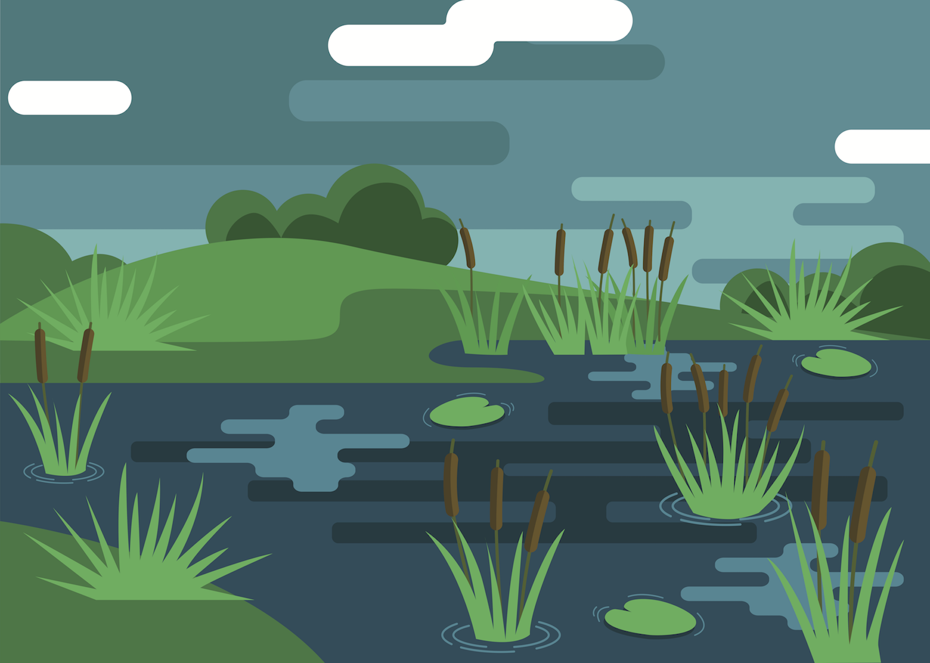
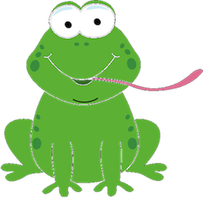
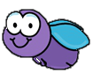
FROG FLY
By: Justin Little, Kahron Jacques-Sorrell, & Nick Jones

Slide 2
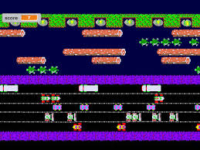
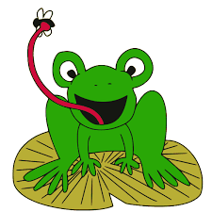
The Concept
The concept of the FrogFly animation is to have an animated frog eat the flies that crosses it’s threshold.
For this we would need two active objects – the frog and the fly.
The original idea was to have an interactive game for the user to be able to direct the frog to the flies.
We also made a priority to have a Start and Reset button for the user to be able to start the game/animation over again.

Slide 3
The Problem
Since this project is pure HTML/CSS, the concept of ”interactivity” is limited.
There is no possibility for Event Listeners which is enabled by JavaScript, only links and animations in CSS.
Because of this, we had to limit the interactivity to a Start & Reset button.
With CSS, we found that animations are created by Keyframes which would be very helpful in creating the FrogFly animation.

Slide 4
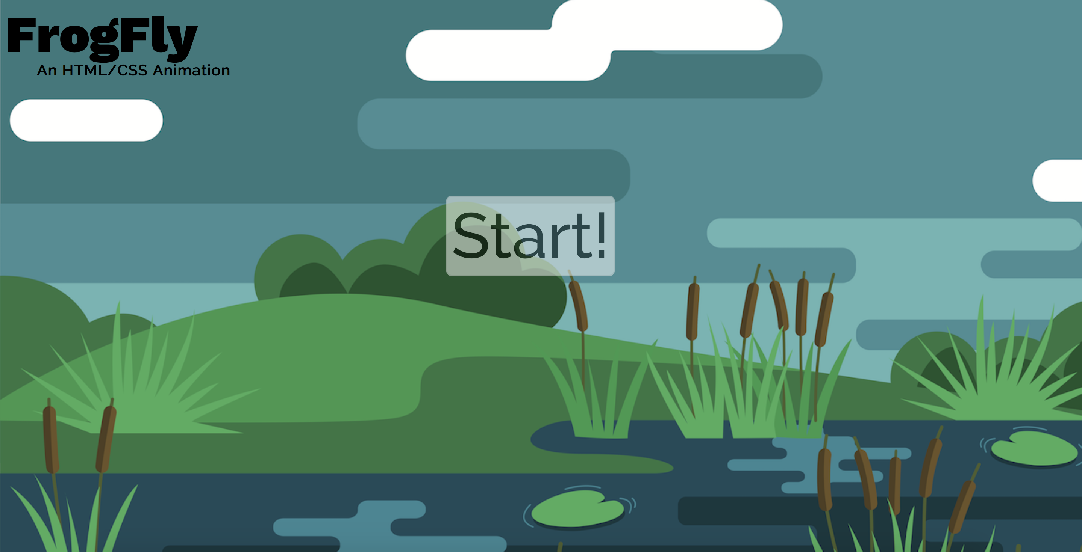
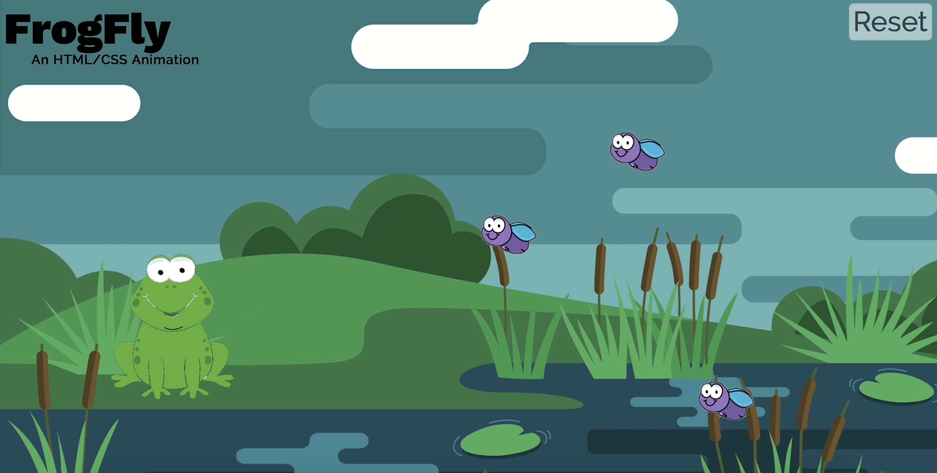
Files
index.html
index.html
game.html
stylesheet.css
Images
background.png
frog.png
tongue.png
fly.png
Start button is pressed
game.html

Slide 5

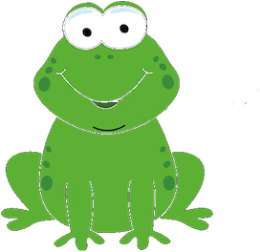
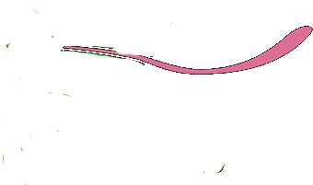

Images
We needed 4 images for this project
Background
Frog
Frog tongue
The idea of the frog’s tongue is to appear at the exact moment that the frog meets the fly.
Fly (4)
Title: “background.png”
Implementation:
<body background = "background.png”
class=“background”>
Title: “tongue.png”
Implementation:
<div class="tongue">
<img src="tongue.png" class="tongue-image">
</div>
Title: “fly.png”
Implementation:
<div class="fly fly1 fly2 fly3 fly4">
<img src="fly.png" class="fly-image-1">
</div>
Title: “frog.png”
Implementation:
<div class=“frog”>
<img src= ”frog.png” class=“frog-image”>
</div>

Slide 6
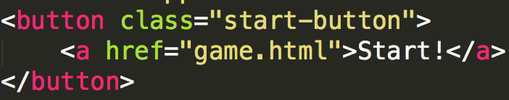
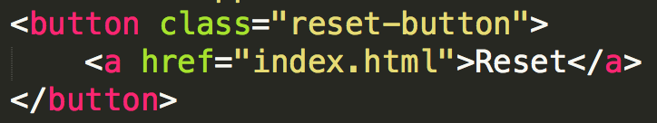
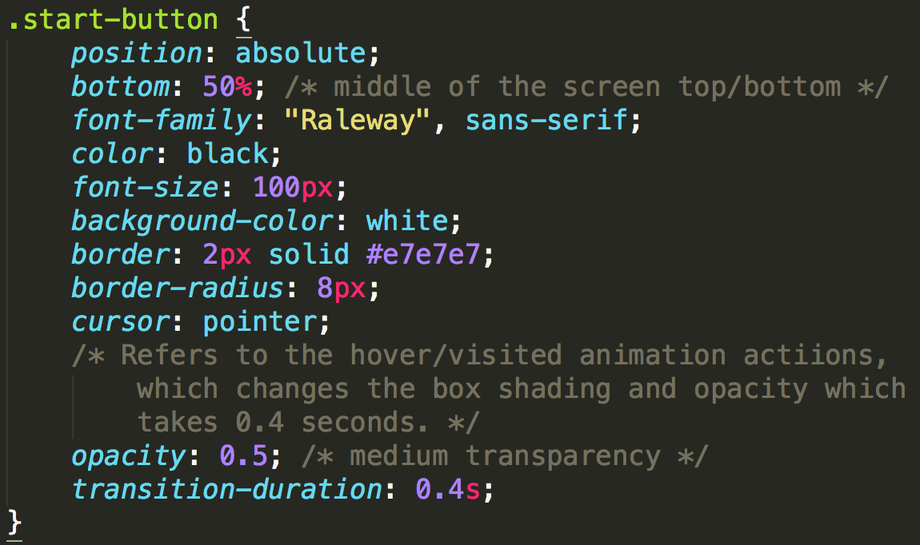
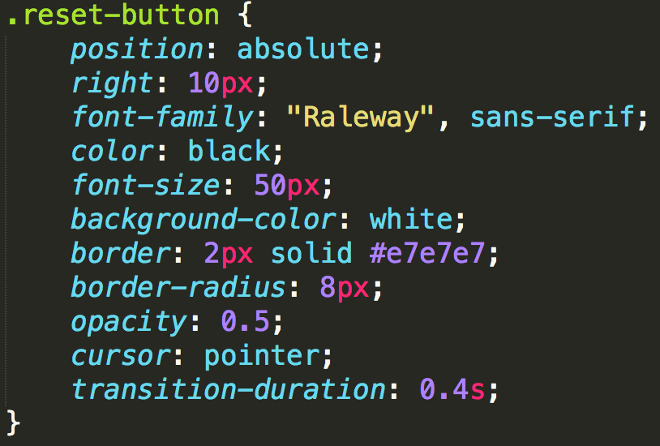
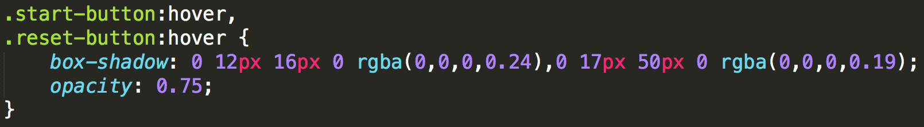
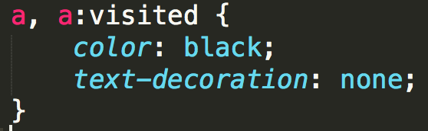
Buttons
Start Button
HTML
index.html
CSS
start-button:hover,
reset-button:hover
This selector allows different formatting when the cursor hovers over the button
Reset Button
HTML
game.html
CSS
a, a:visited
This selector allows different formatting of a link, and a link that’s been visited already.

Slide 7
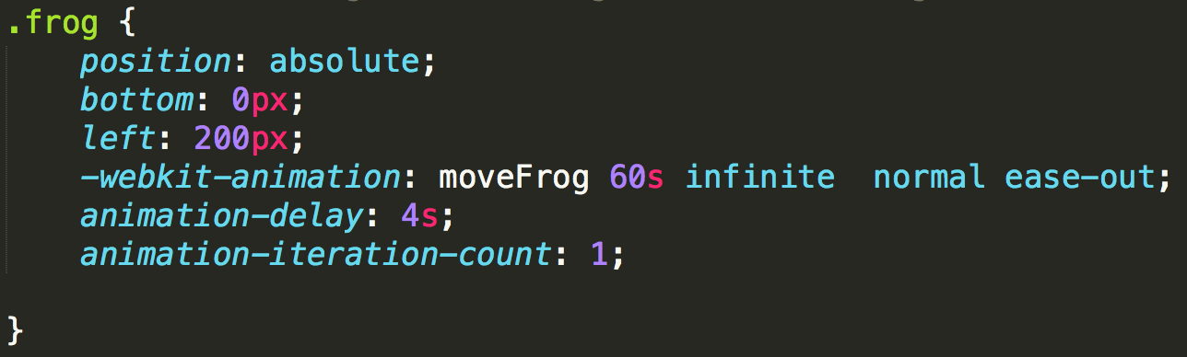
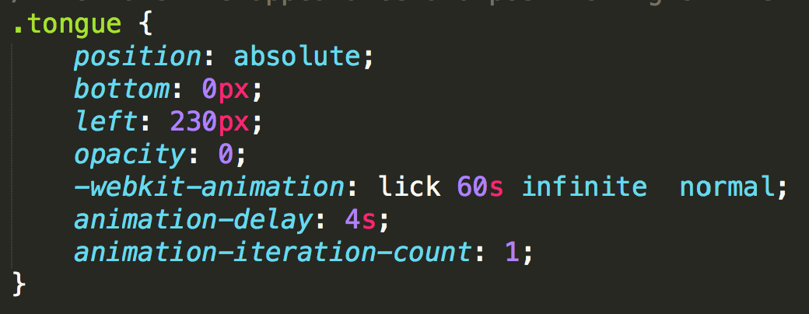
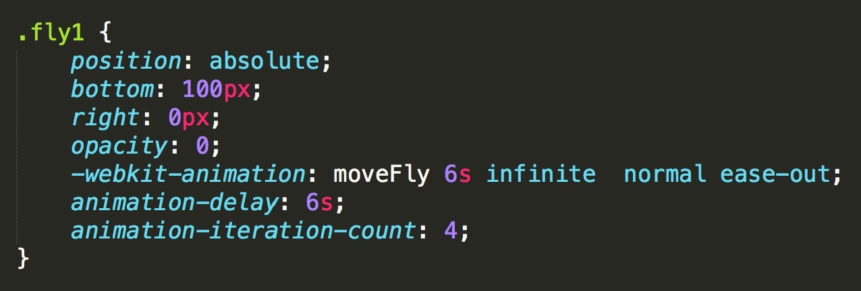
The Object Formatting
The frog
Uses the keyframe “moveFrog”
Animation is delayed by 4 seconds
Entire animation lasts 60 seconds.
1 iteration
The tongue
Follows the same formatting as the frog to follow along with it
Uses the keyframe “lick”
Starts at 0 opacity
The flies
Uses the keyframe “moveFly”
There are 4 fly objects, so the animation settings vary by fly (speed, delay, iteration count)

Slide 8
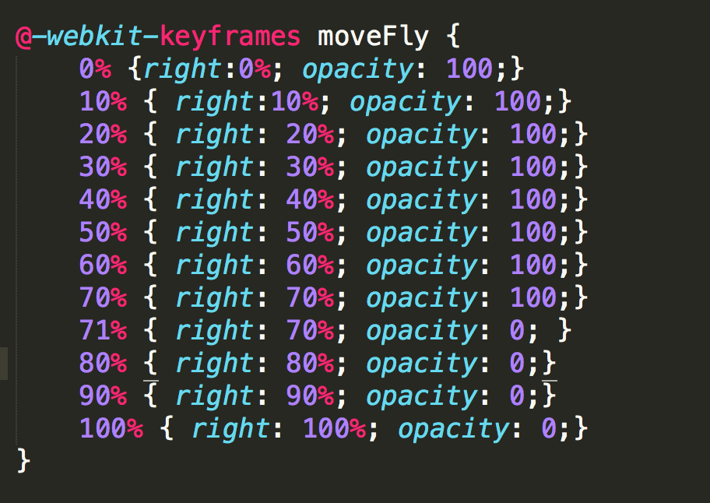
Keyframes
moveFly
The percentages on the left-hand side represent the time throughout each interval of the animation.
"right: 0-100%" shows the position of the flies acrross the screen from right to left.
The opacity is adjusted to 100 until 70% of the animation, where the fly disappears, which is "opacity: 0"

Slide 9
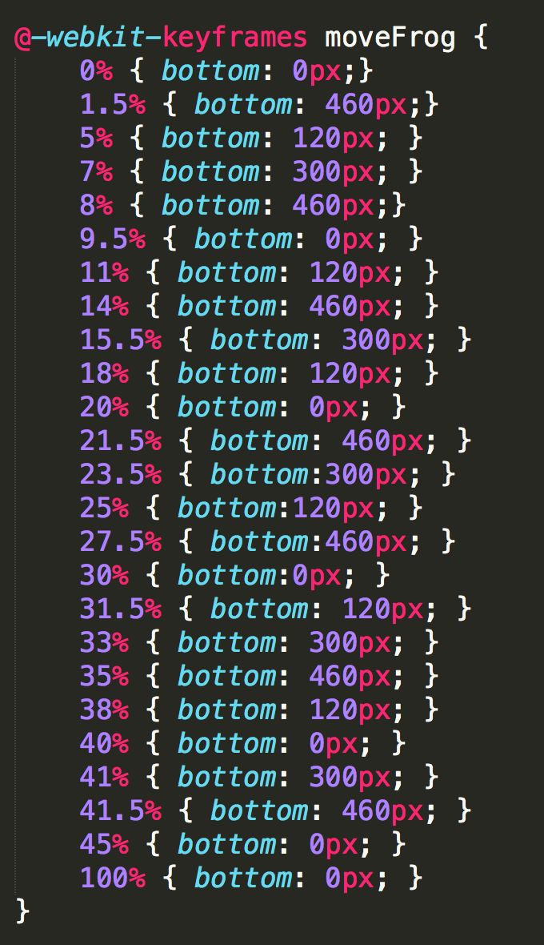
Keyframes (cont’d)
moveFrog
The following is a keyframe called "moveFrog" which directs the animation for the "frog" image to move to the fly.
This effect will create the effect that the frog is catching the fly.
The percentages throughout the animation interval are set based on what timeframe throughout the 60 second animation the fly reaches the frogs vicinity (70% of the screen from the right margin).
The positioning (Ex. bottom: 460px) is adjusted every time a new fly crosses the frog's threshold.
The positions are exactly the same as the fly's (set from the bottom margin) so that the frog meets the fly at the exact position.

Slide 10
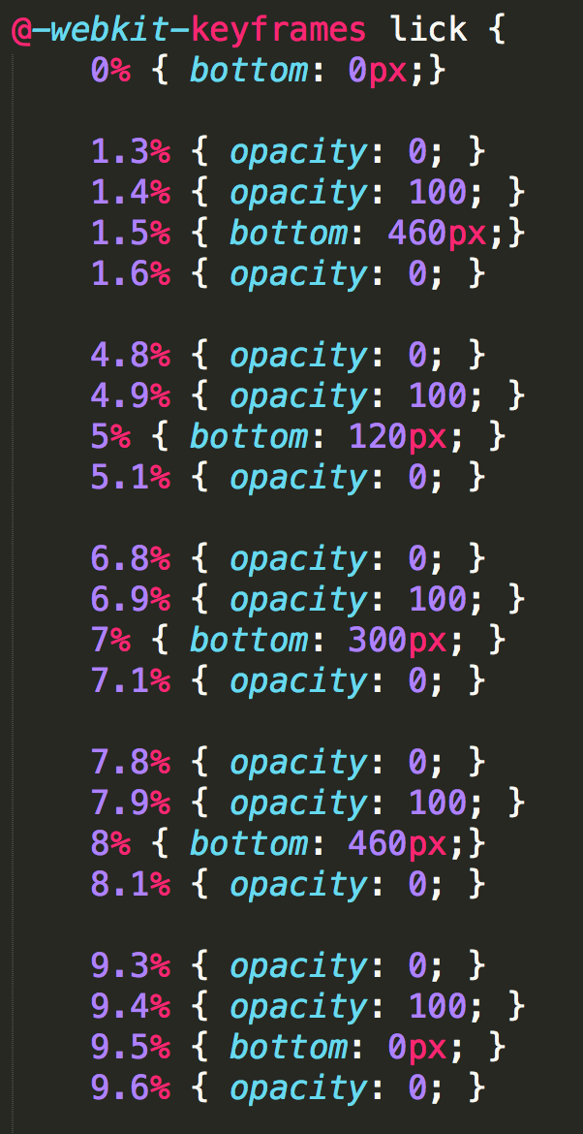
Keyframes (cont’d)
lick
This keyframe directs the animation for the "tongue" image to move with the frog & appear at the time the frog meets the fly.
The opacity is set to 0 to begin with, and is adjusted to 100 at 0.1s before and disappear 0.1s after the frog reaches the fly.
The positioning (Ex. "bottom: 460px") is adjusted the same as the keyframe "moveFrog” so that the "tongue" image follows the normal "frog" image.

Slide 11
Resources
CSS Keyframes (W3 Schools)
https://www.w3schools.com/cssref/css3_pr_animation-keyframes.asp
Background Image
https://www.vecteezy.com/vector-art/175348-marsh-illustration-vector

